Slide 1

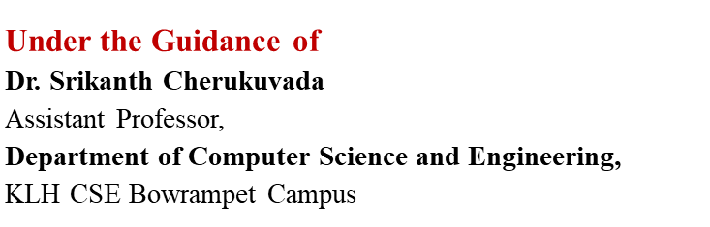
PharmaVerse AI: An Agentic Pharmaceutical Supply Chain Monitoring and Drug Traceability Ecosystem
SOA and Microservices Project Review-1
Thursday, August 20th, 2026
Team-23:
Y. Nihitha - 2420090099
A.Sri Anitha - 2420090117
T. K. Amulya - 2420030434
S. Harini - 2420030523

Slide 2
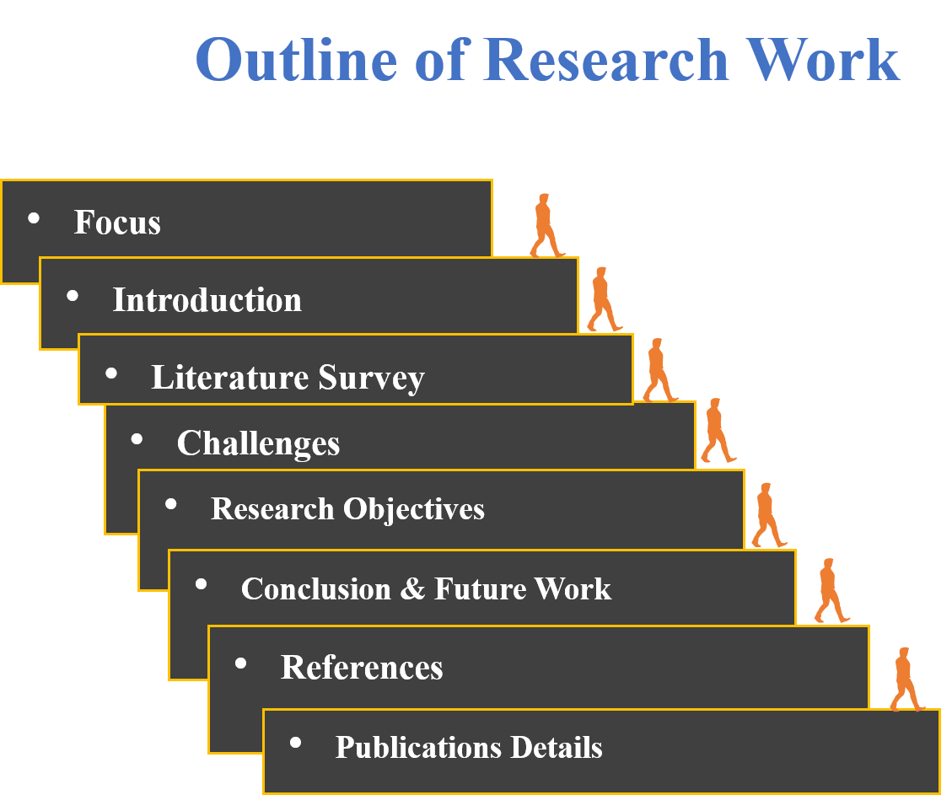

Slide 3
Problem Statement
Traditional pharmaceutical supply chains rely on fragmented and centralized systems, making drug tracking, verification, and monitoring inefficient.
Counterfeit drugs, poor visibility, and supply chain disruptions can compromise medicine safety and availability.
Existing solutions often lack real-time tracking, secure data sharing, and end-to-end drug traceability.
There is a need for a secure, transparent, and real-time system that can authenticate medicines, monitor their movement, and detect supply chain anomalies.
The proposed PharmaVerse AI integrates Hyperledger Fabric, RFID, IoT, FastAPI, Docker, PostgreSQL, and QR-based traceability to enable secure drug tracking, anti-counterfeiting, and intelligent pharmaceutical supply chain monitoring.

Slide 4
Objectives
To develop a secure and transparent pharmaceutical supply chain using Hyperledger Fabric.
To enable end-to-end drug traceability using RFID and QR codes.
To detect and prevent counterfeit and unauthorized medicines through secure verification.
To provide real-time monitoring of drug movement and supply chain conditions using IoT.
To use AI-based intelligent monitoring for detecting anomalies and potential supply chain disruptions.
To integrate the system using FastAPI, PostgreSQL, and Docker for scalable and efficient deployment.
To improve medicine safety, availability, and supply chain transparency.

Slide 5
Literature Survey
AUTHORS | TITLE OF THE PAPER | METHODOLOGY | INFERENCES | LIMITATION/FUTURE WORKS
Mueen Uddin [1] | Blockchain Medledger: Hyperledger Fabric Enabled Drug Traceability System for Counterfeit Drugs in Pharmaceutical Industry – 2021 | • Uses Hyperledger Fabric for permissioned blockchain. • Implements smart contracts for drug transactions. | • Enables secure and transparent drug traceability. • Helps identify unauthorized medicines. | • Faces scalability and deployment challenges. • Integration with existing pharmaceutical systems needs improvement.
S. S. Gomasta et al. [2] | PharmaChain: Blockchain-based Drug Supply Chain Provenance Verification System – 2023 | • Uses Hyperledger Fabric with on/off-chain storage. • Uses cryptographic signatures for secure verification. | • Improves drug provenance and accountability. • Provides tamper-resistant supply-chain records. | • Requires better scalability and interoperability. • Governance and stakeholder adoption remain challenges.
N. El Akrami et al. [3] | DrugTrace: Leveraging Blockchain and IoT for Anti-Counterfeit Drug Traceability – 2026 | • Integrates Blockchain, IoT and AI for drug tracking. • Uses Random Forest for certificate validation. | • Enables real-time drug condition monitoring. • AI helps detect potentially fraudulent certificates. | • AI evaluation requires validation with real-world datasets. • Large-scale deployment needs further study.

Slide 6
Research Gap Identification
Fragmented Supply Chain Data: Existing pharmaceutical supply chains operate across multiple stakeholders and isolated systems, limiting seamless information sharing and end-to-end visibility.
Limited Real-Time Traceability: Conventional tracking mechanisms do not consistently provide real-time visibility of drug movement across manufacturers, distributors, pharmacies, and other supply-chain nodes.
Weak Counterfeit Detection: Existing verification approaches may rely on centralized records or isolated authentication mechanisms, making unauthorized substitution and counterfeit detection difficult.
Insufficient Supply Chain Intelligence: Most existing systems focus primarily on tracking and record management, with limited capability to identify abnormal movement patterns, delays, or potential supply-chain anomalies.
Security and Trust Challenges: Centralized data architectures create dependency on a single authority and provide limited tamper-resistant, shared verification among multiple stakeholders.
Research Gap: A unified ecosystem integrating blockchain-based trust, IoT/RFID-based real-time monitoring, QR-based medicine verification, and intelligent anomaly detection for secure end-to-end pharmaceutical traceability remains insufficiently addressed.

Slide 7
Innovation, Creativity, and Novelty
Blockchain-Enabled Trust: Hyperledger Fabric provides a permissioned, tamper-resistant ledger for secure and accountable sharing of pharmaceutical transaction records among authorized stakeholders.
Physical–Digital Drug Linking: RFID + QR traceability creates a digital identity for medicines and links their physical movement with verifiable supply-chain records.
Real-Time IoT Monitoring: IoT devices continuously capture relevant movement and environmental data, improving visibility beyond conventional static tracking.
Agentic AI-Based Intelligence: AI agents can analyze supply-chain events, identify abnormal patterns, detect potential disruptions, and support intelligent monitoring rather than merely storing transaction data.
End-to-End Traceability: The proposed architecture connects manufacturing → distribution → transportation → pharmacy → verification, enabling complete medicine provenance.
Integrated Anti-Counterfeiting: Combining blockchain records with QR/RFID verification enables stakeholders to validate medicine identity and detect inconsistencies between physical products and digital records.
Novelty: PharmaVerse AI unifies blockchain, IoT/RFID, QR traceability, and agentic intelligence into a single pharmaceutical supply-chain ecosystem, moving beyond conventional tracking systems toward secure, real-time, intelligent, and anomaly-aware drug traceability.

Slide 8
Feasibility
Technical Feasibility
Uses Hyperledger Fabric, RFID, QR, IoT, AI/ML, FastAPI, PostgreSQL, and Docker.
Modular architecture allows components to be developed and tested independently.
Docker supports consistent and scalable deployment.
Operational Feasibility
Monitors drug movement and environmental conditions in real time.
Enables medicine verification and end-to-end traceability.
AI detects anomalies, delays, and unauthorized activities.
Economic Feasibility
Uses open-source technologies, reducing licensing costs.
Software simulation minimizes initial hardware investment.
Early detection of counterfeits and disruptions reduces losses and wastage.

Slide 9
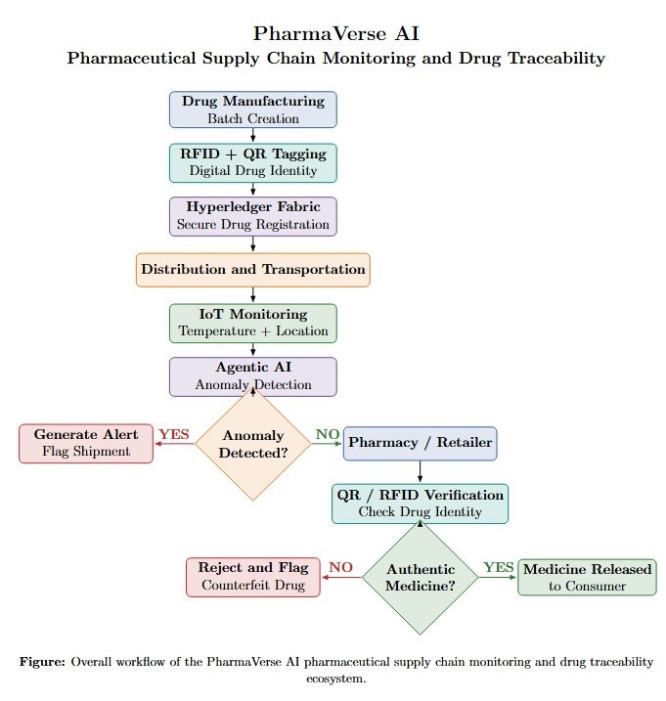
Workflow:

Slide 10
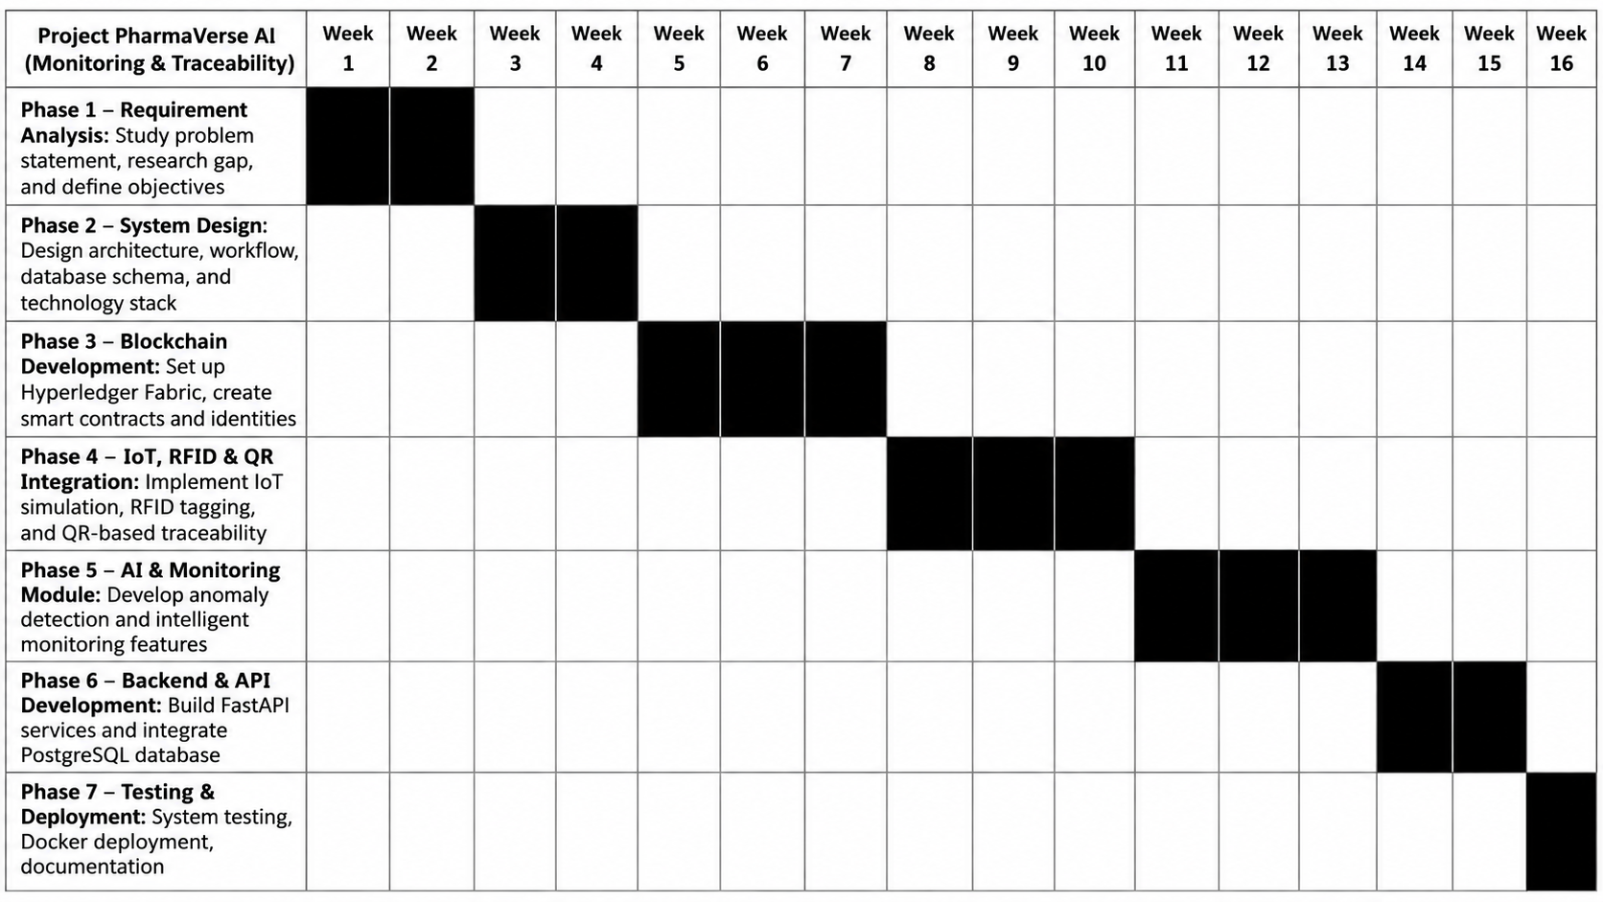
Project Plan
Project Phases & Timeline
Phase 1 – Requirement Analysis: Study smart-grid faults, RTOS, and system requirements — Week 1–2
Phase 2 – System Design: Design the adaptive RTOS and edge architecture — Week 3–4
Phase 3 – AI Model Development: Prepare fault data and develop the fault-detection model — Week 5–7
Phase 4 – RTOS & Edge Development: Implement real-time monitoring and task scheduling — Week 8–10
Phase 5 – Self-Healing Module: Implement fault isolation and automatic recovery — Week 11–13
Phase 6 – Integration & Testing: Integrate components and test different fault scenarios — Week 14–15
Phase 7 – Evaluation & Documentation: Analyze results and prepare final documentation — Week 16

